Slide 1
Web Project Structure

Slide 2
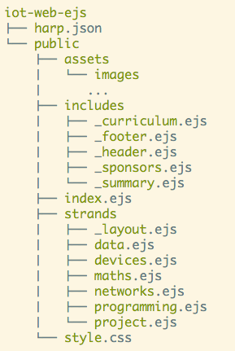
Motivation
Maintaining a coherent and consistent structure significantly simplifies the management and evolution of the web project
Every type of file having its place simplifies decision making and keeps the project from becoming chaotic and error prone

Slide 3
Project Structure
harp.son
public
assets folder
includes folder
other content folder(s)
index.ejs
style.css

Slide 4
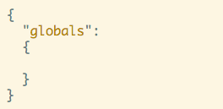
harp.json
Required for Harp server
Can be use to store information available to the web pages
We will leave blank for the moment

Slide 5
public folder
All of our project files must be in the public folder.
If we were building an web application (as opposed to a web site), then other folders would be required in addition to public

Slide 6
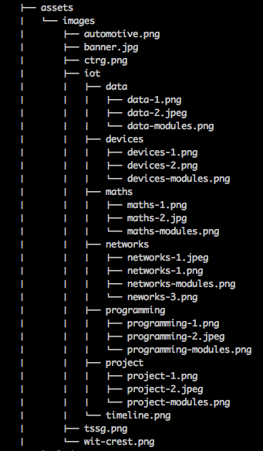
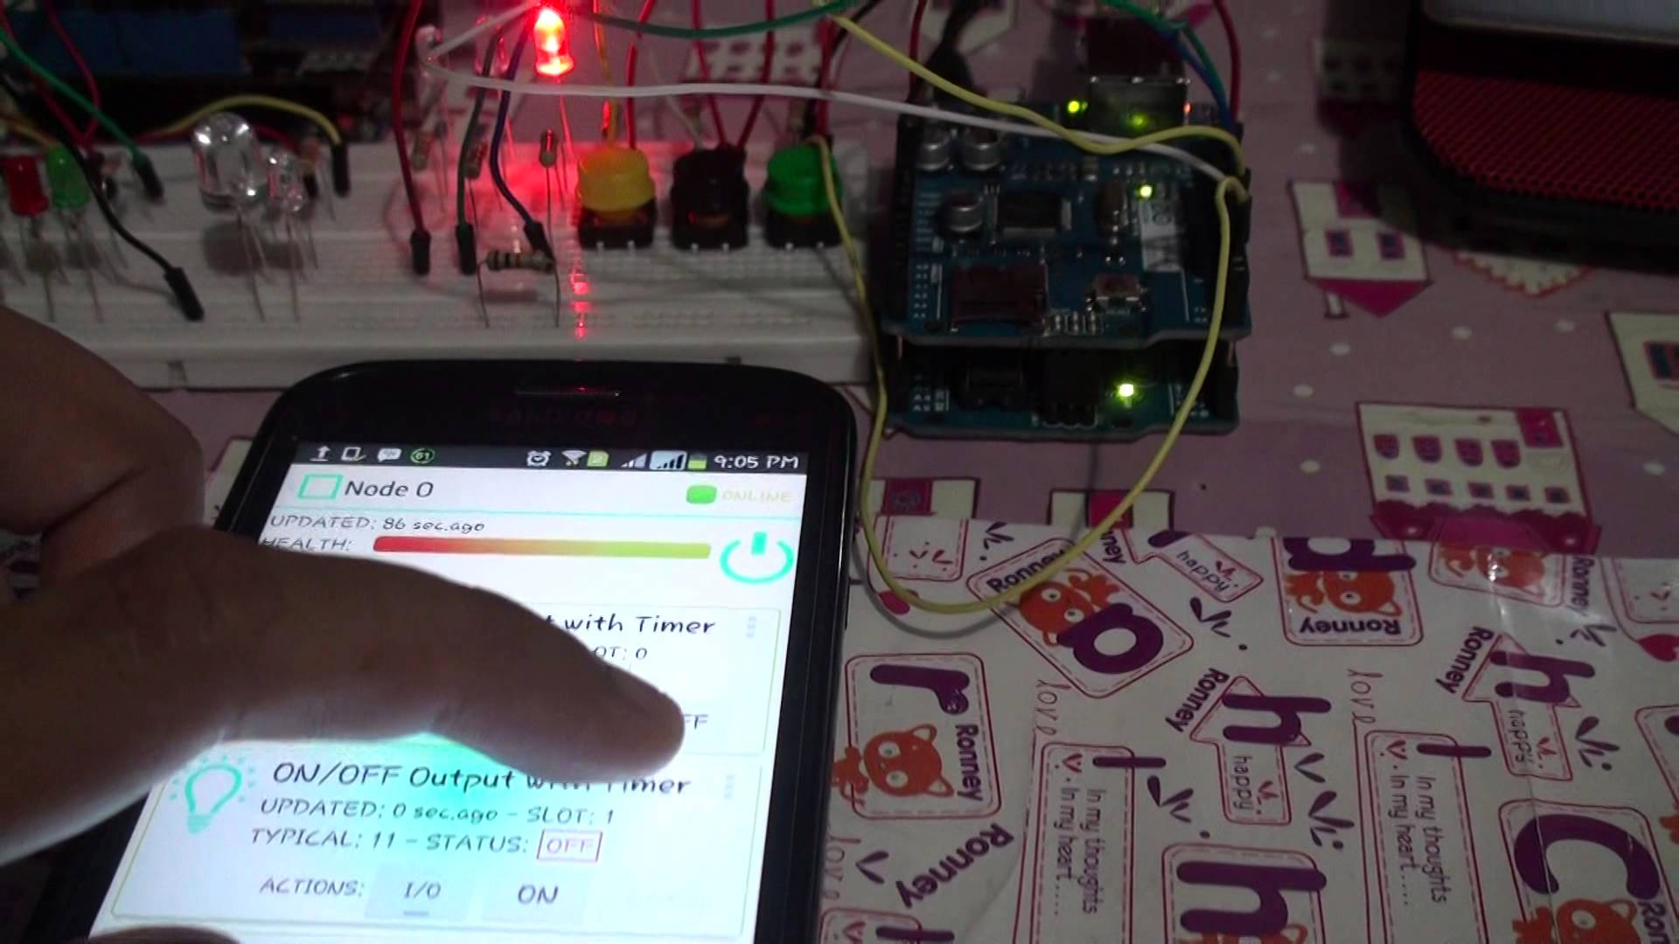
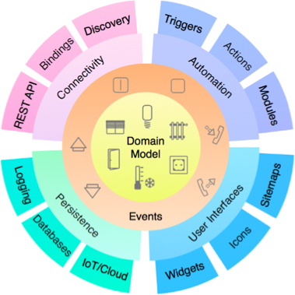


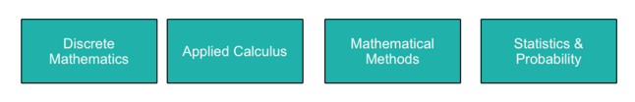
Assets folder
Contains all ‘read only’ files for your project. i.e. files you will not edit or modify
Typically:
images
css libraries
js libraires

Slide 7

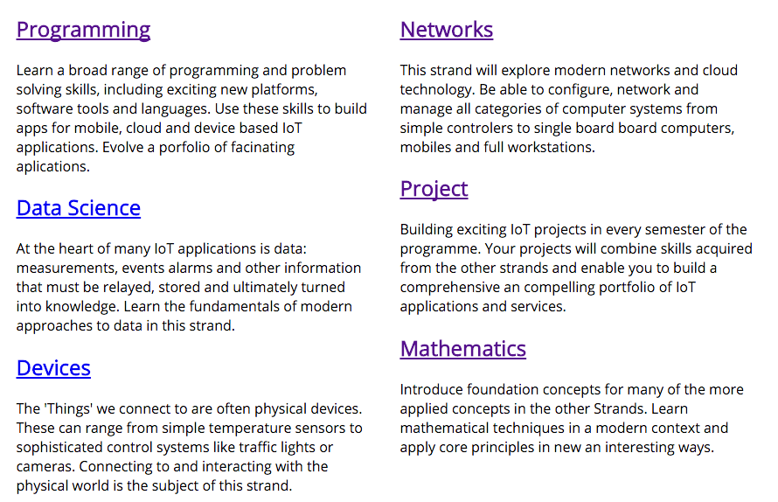

Includes Folder
Reusable ‘fragments’ of pages
Deliberately given the “_” prefix (explained later)
These templates can be imported to other pages via the ‘partial’ statement

Slide 8

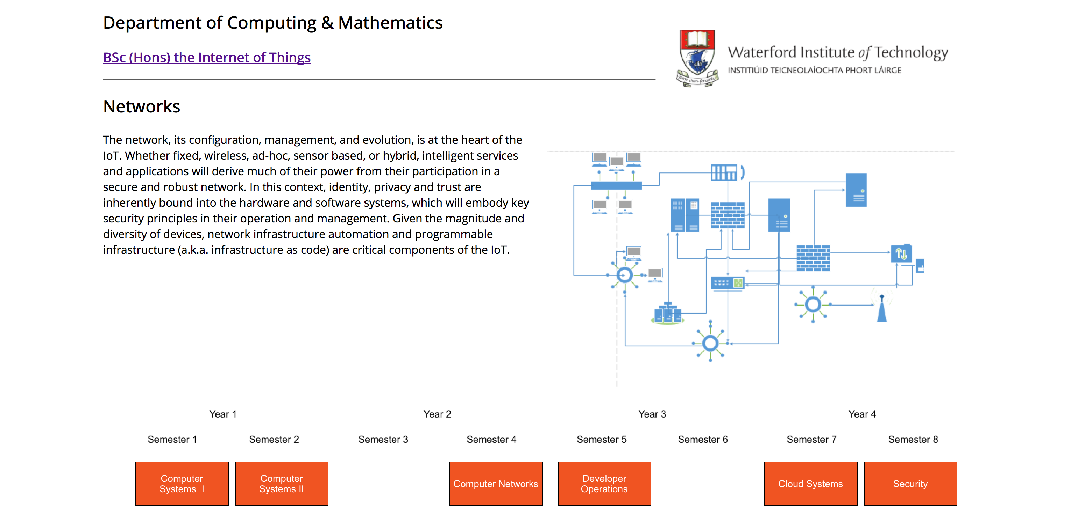
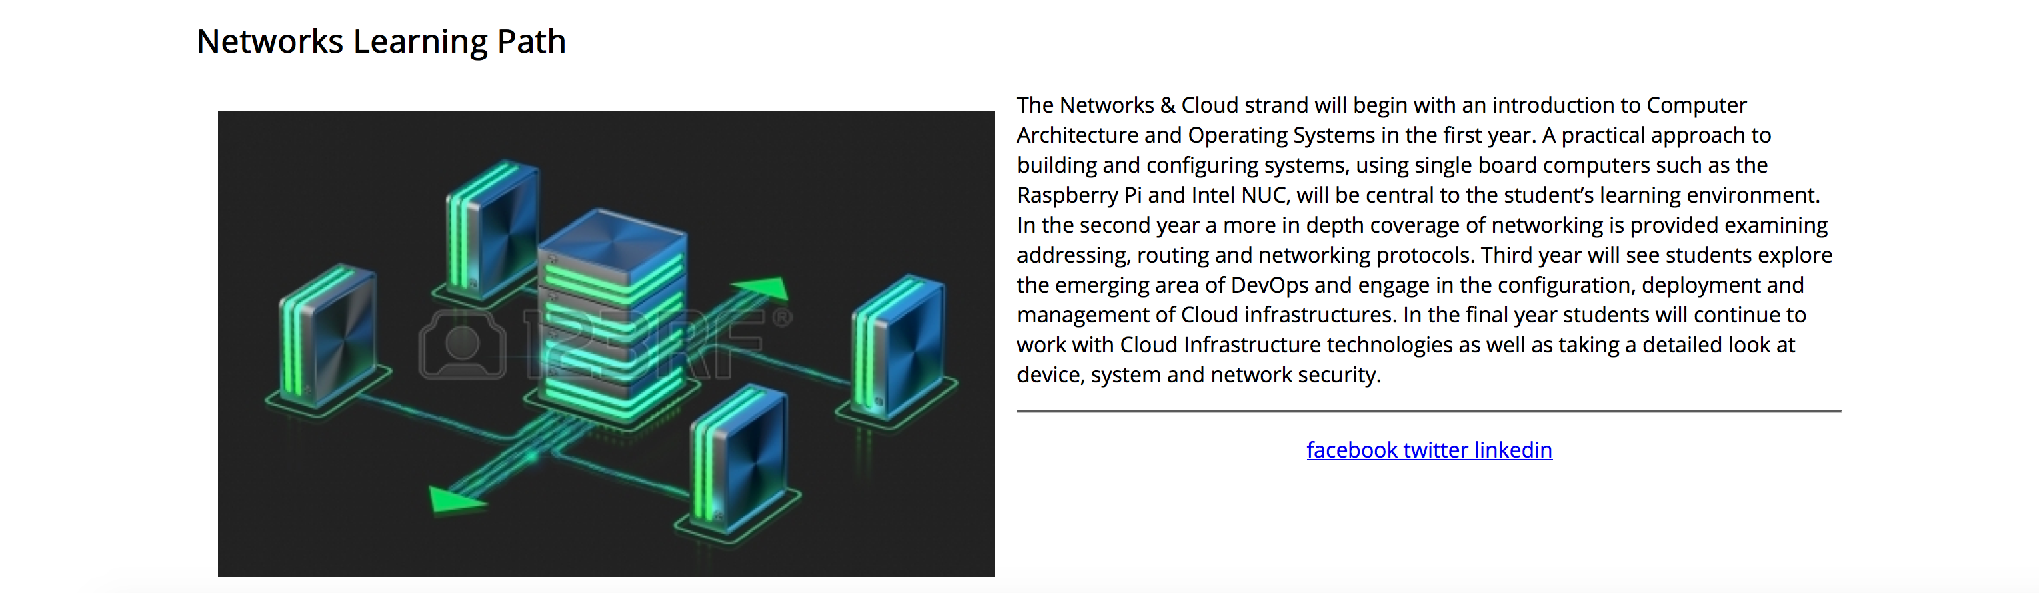
Other Content folders
Groups related parts of your content into folders
These can share a common “_layout.ejs”
‘strands’ is a name selected for the IoT web site
your project should select a different appropriate folder name
You may have more than one such folder

Slide 9

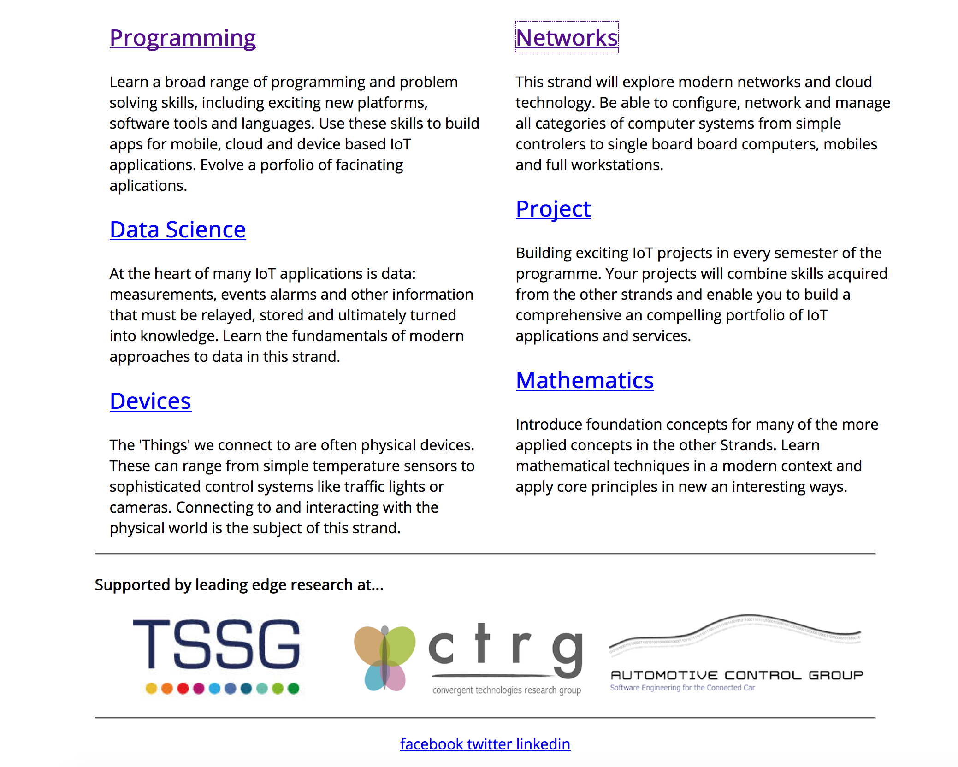
index.ejs
The “Home” or “Start” page
Must be called index.ejs (not home)
Will be the default page loaded when the site is deployed

Slide 10
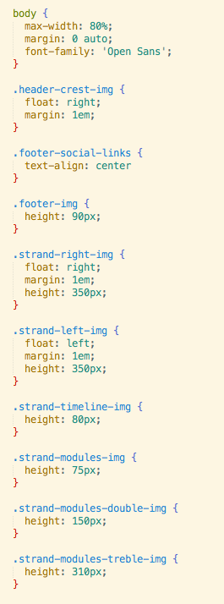
style.css
The main stylesheet for your site
You may have additional stylesheets in certain circumstances

Slide 11
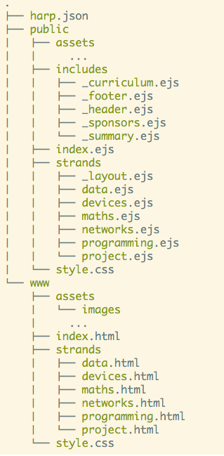
Compiling pages
“harp compile” command will generate a ‘build’ of the web site in www folder, replacing all templates with a generated static version of the site
Useful for deployment…
.. although not necessary for surge, as the surge service includes an ejs template engine

